Slide 1
Optimising Operations: Strategies to Overcome Insufficient Workforce, Superfluous Inventory and Inadequate Clientele of a Wholesale Company. BDM Capstone Project 2024
Ikshwaku Tiwari 21f1003999

Slide 2
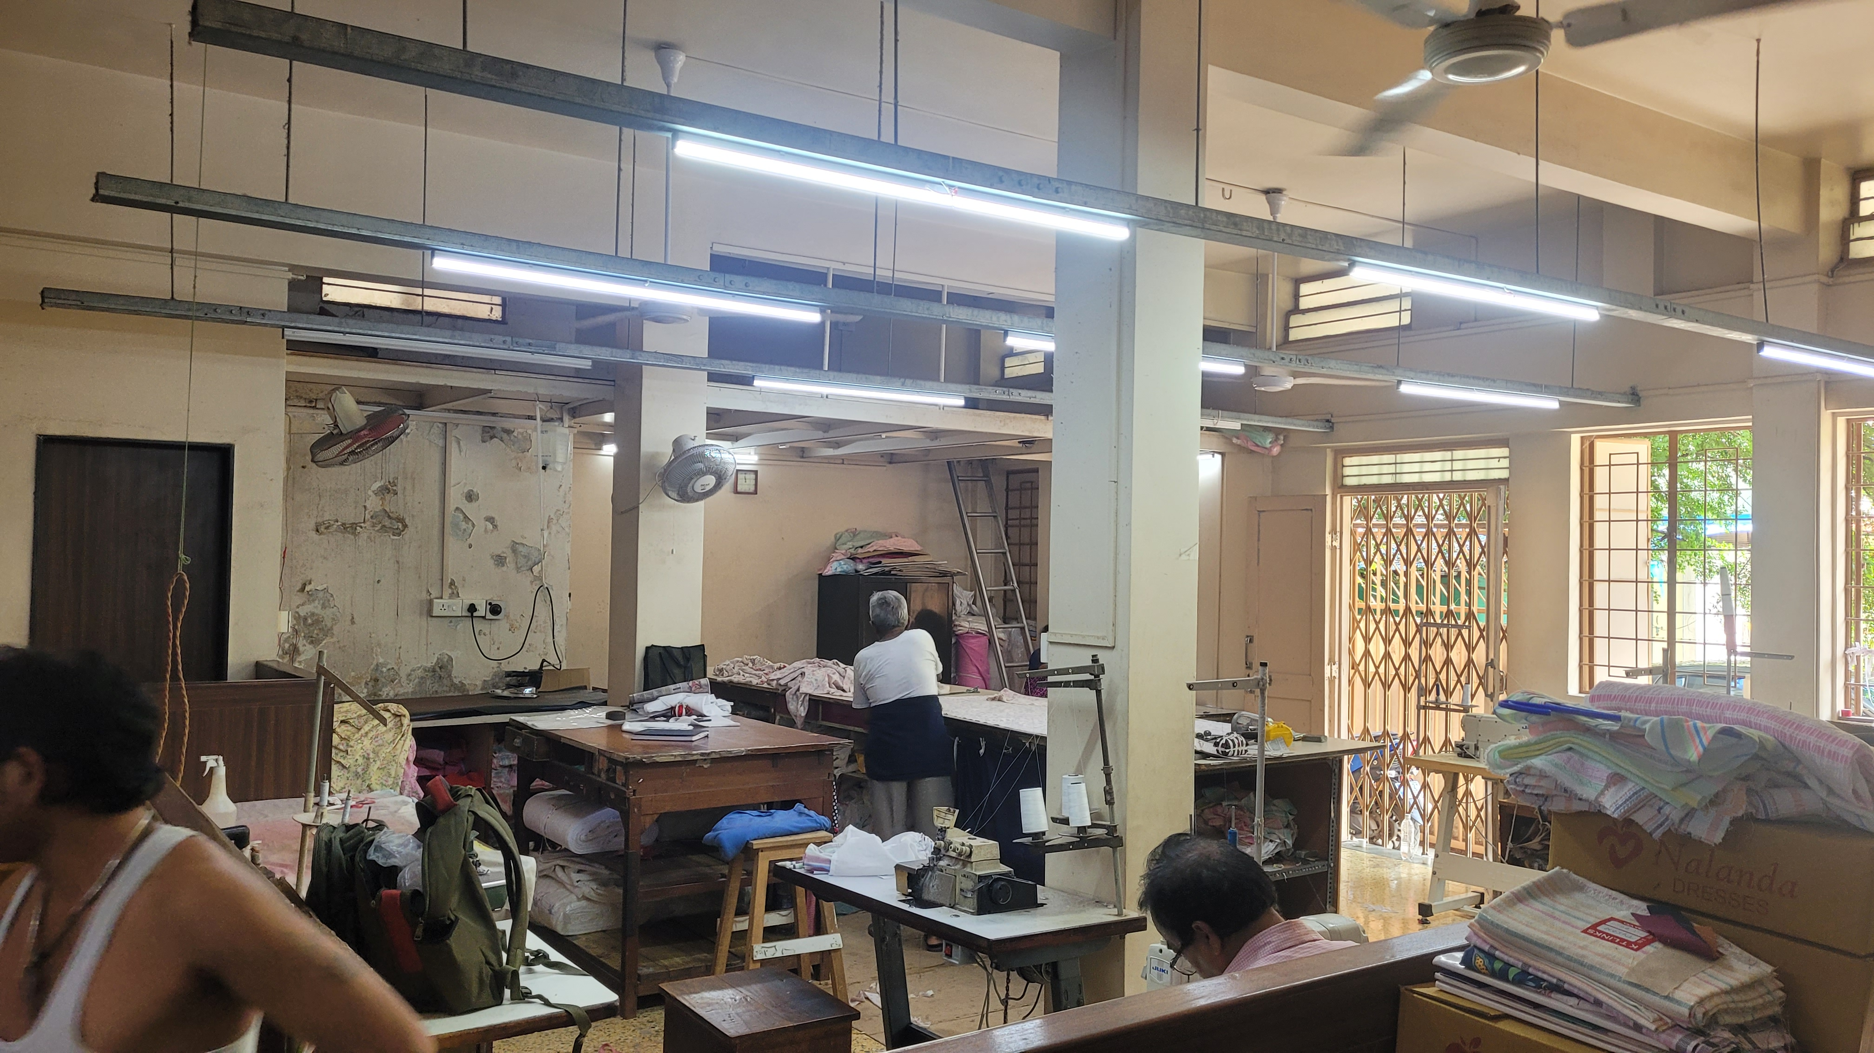
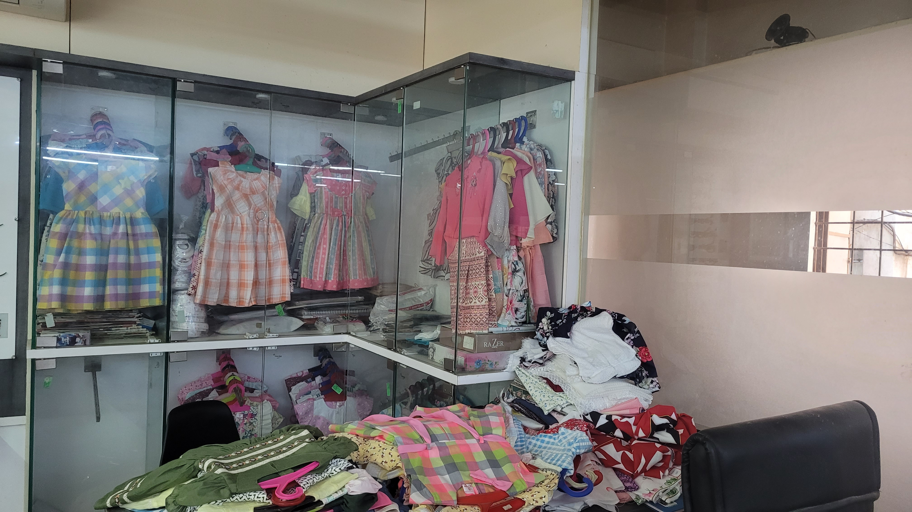
Introduction and Organisation Details
A wholesaling company operating in B2B markets was selected as part of the diploma-level capstone project.
Nalanda Dresses, established in 1970 by Mr. Subodh D. Shah, is located in Somwar Peth, Pune, and is presently managed by Mr. Mehul Shah.
The organization comprises the following sections: two offices, one manufacturing area, and a small inventory storage section.
The company specializes in producing and distributing girls' dresses featuring a variety of classic patterns and designs, crafted from materials such as cotton, linen, and synthetics.

Slide 3
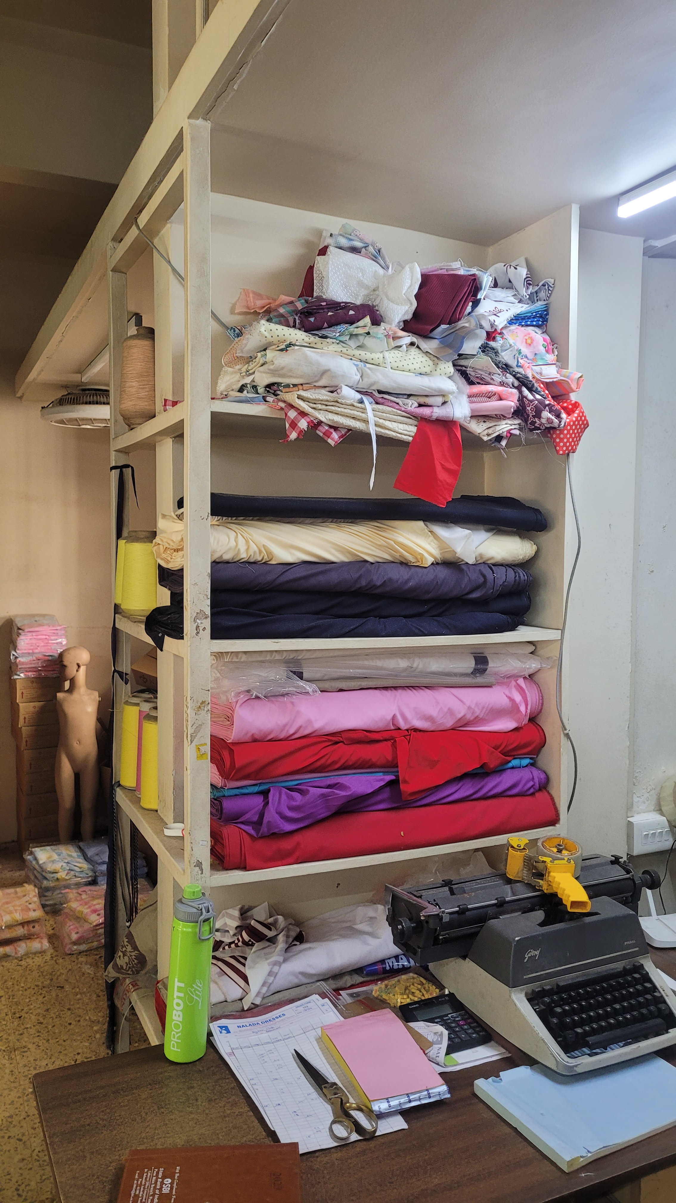
Problem Statements
Surplus Inventory: Unable to halt production, the inventory is always superfluous, increasing storage costs and reducing profitability.
Shortage of Manpower/Heavy workload: Insufficient labour is leading to increased workloads amongst the existing employees
Limited Demand Locally: The company’s distribution strategy caters to the southern states of India.

Slide 4
Data Collection: Kinds and Methods
The raw data was collected and subsequently digitized for thorough analysis.
Sales Data
Date
Company Name
Items
City/Town
Sales
Employee Data
Jobs
Number Of Employees
Fabric data
Material
Price Range
Employee and fabric data were gathered through direct interactions with the company's owners and employees.
The sales data collected ranges from August 2023 to December 2023 and from April 2024 to August 2024.

Slide 5
Data Analysis Approach
Organisation Problems included:
Lack of Inventory management
No segregation of items based on materials.
To solve the problems, a sales prediction approach was taken, and a Machine Learning model was built to forecast sales based on existing data.
Data Preprocessing
Cleaning the data
Model Building
Selecting the best performing models based on evaluation metric
Model Evaluation
Plotting Graphs like Residual Plots, Feature Importance Plots and Sales Prediction Plot
Understanding the Data Distribution
Creating Interactive Features
Hyperparameter Tuning the best models
To understand what customer companies Nalanda Dresses caters to, a tree map of the top 10 companies is plotted that highlights the sales of each company as well.
Further a heatmap is created to highlight what geographical areas have a high-density sale.
A hypothetical parameter is introduced to calculate the travel expense incurred while transporting the goods.

Slide 6
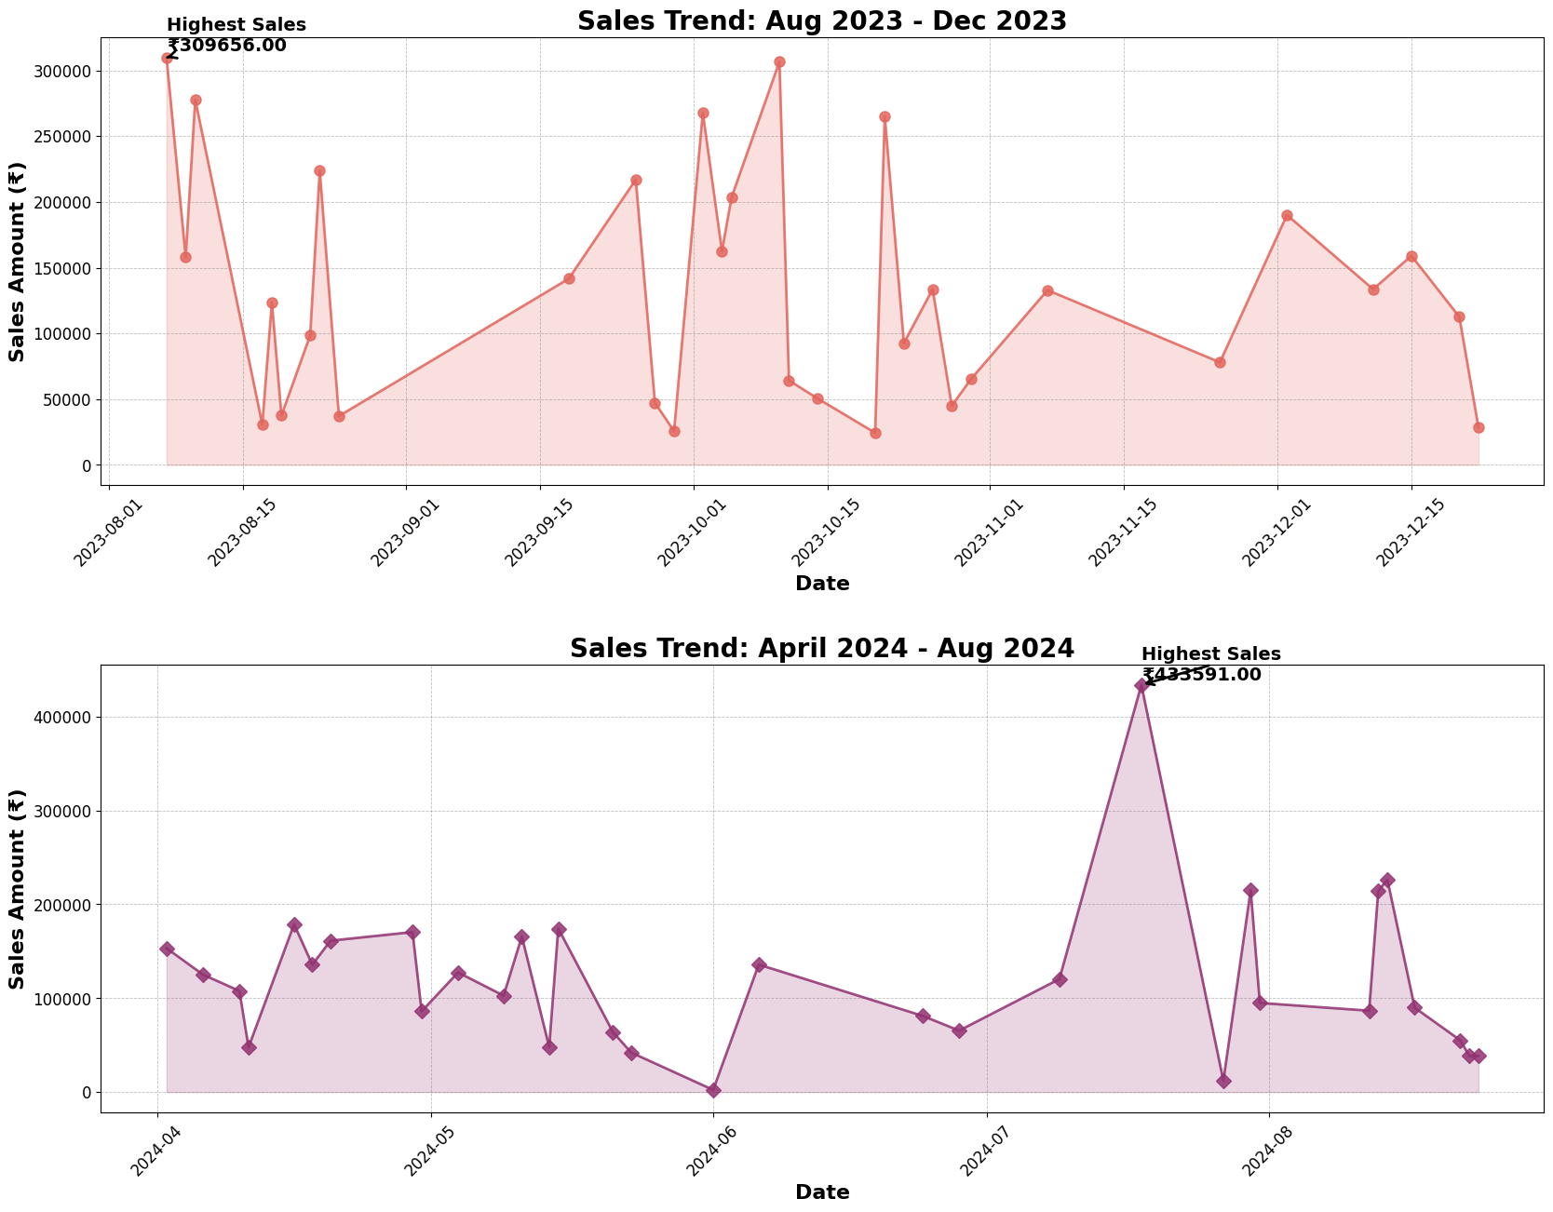
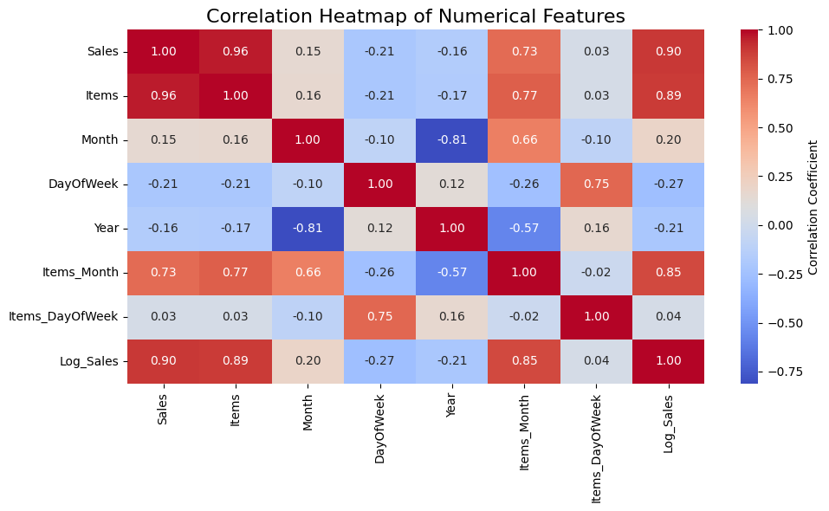
Results And Interpretation:
The line plot shows the sales of the company from the period of August 2023 – December 2023 and April 2024 – August 2024. The visible spikes are driven by the seasonal demand during the festivities like Ganesh Chaturthi and Diwali.
There is a larger spike in mid-July 2024 (₹4,33,591) compared to mid-September 2023 (₹3,09,656).
Sales Trend: Comparison between two time periods.

Slide 7
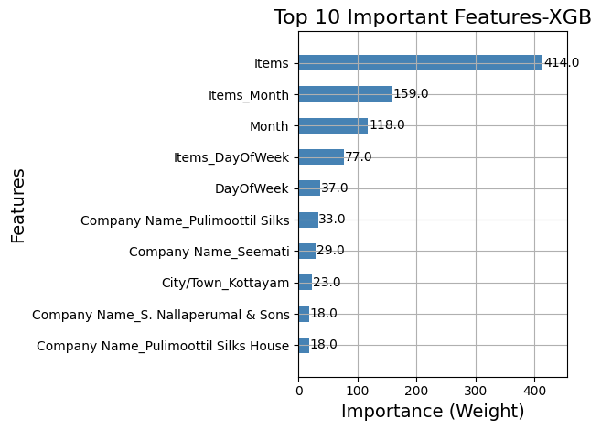
Sales Prediction Plot Interpretation and Metrics:
Test MSE: 0.010447737673983713, Test R2 Score: 0.9659168801507542.
The model achieves a 96% accuracy, indicating its ability to predict sales with a high degree of precision based on the existing data. The metrics demonstrate the model’s effectiveness in capturing the underlying patterns and relationships in the data, making it a reliable tool for forecasting sales trends and informing business decisions.
Feature Importance Plot Interpretations:
Due to a strong correlation with the target variable (Sales), the feature ‘Items’ has the most significance (weight = 414). The other important features include Items_Month, Month, Items_DayOfWeek and Day_OfWeek, this suggests a seasonal implication for sales.

Slide 8
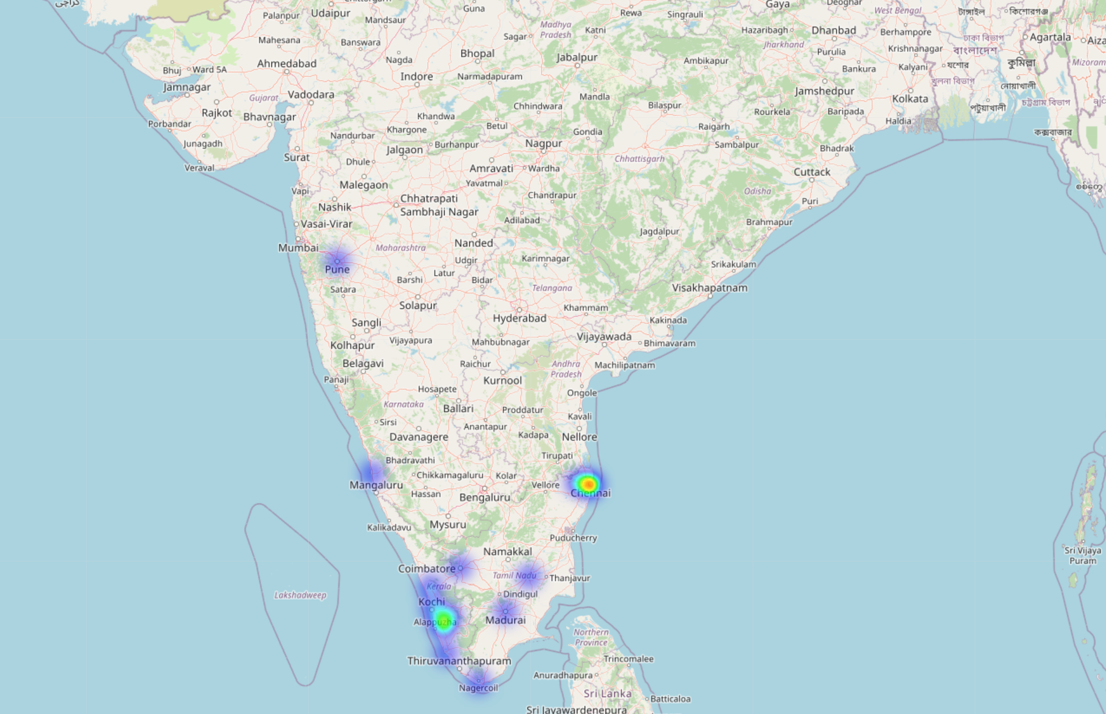
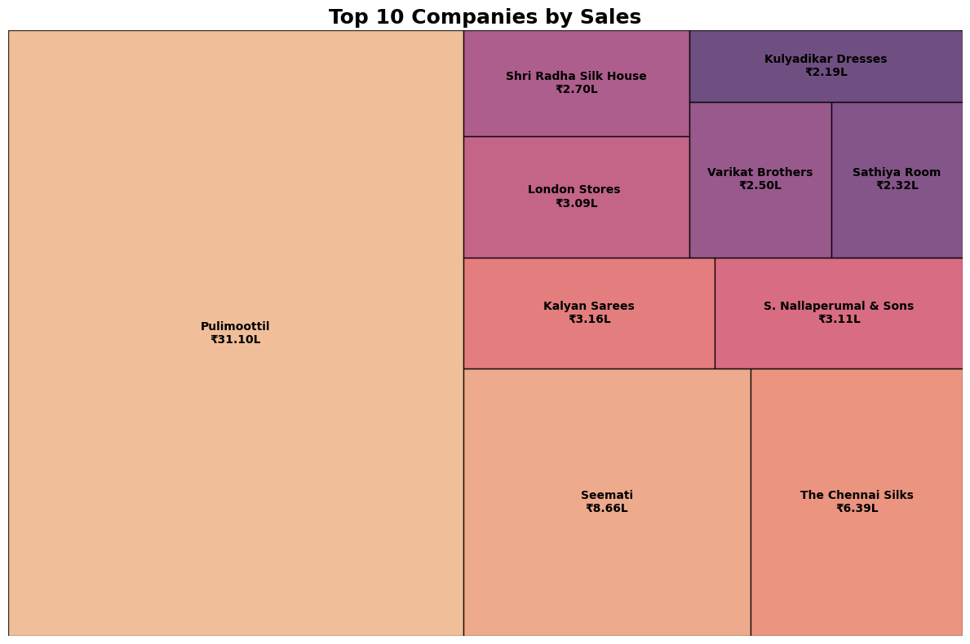
Heat Map for Sales Density
Chennai and Kottayam are the cities having the highest sales density.
Cities like Nagercoil, Tiruvallur, and Thrissur have moderate sales density.
And the western part of India (where the home company is located), one can see negligible to no sales.
Tree Map For Top 10 Sale Contributors
The largest sales contributor to Nalanda dresses is Pulimoottil with 31.10 lakhs of sales with approximately 40 percent of sales.
The tree map gives a clear distinction between customer companies making it easy to identify the top contributing companies sales-wise.

Slide 9
Recommendations:
Surplus Inventory and Lack Of Labour
Demand Forecasting by creating an interactive dashboard using the ML Model created.
Proper Inventory Management System and Segregation of Products based on the best-selling products.
Dynamic Labour Planning and Outsourcing Tasks during peak sales periods.
JIT(Just In Time) delivery introduction to reduce storage costs.
Lack Of Local Clientele
Cross Promotional Strategy with local schools
Create an efficient marketing strategy to establish a local clientele.
Establishing an online presence and relying on third party logistics services for time efficiency.

